Slide 1
Sorting Problem
Akhtamov Azimjon, 2024299010
9.27.2024

Slide 2
Problem Definition (1)
Source: Codeforces (Kotlin Heroes Contest)
Title: Sorting Problem
Difficulty: Easy
Usage: -

Slide 3
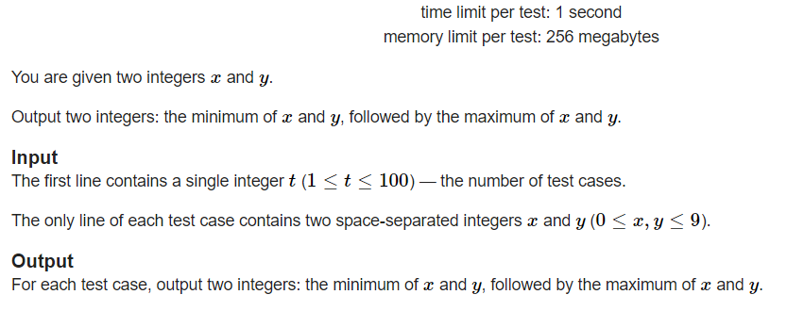
Problem Definition (2)

Slide 4
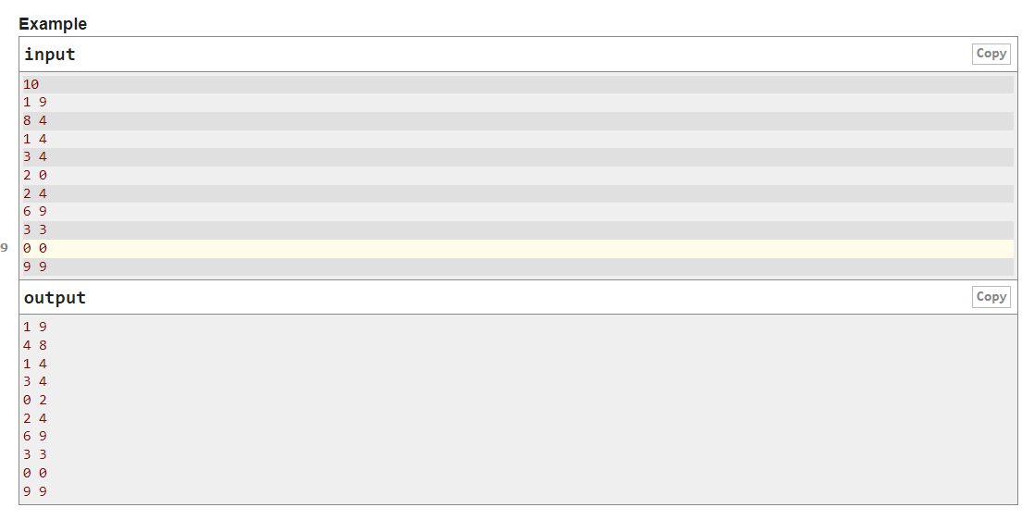
Problem Definition (3)

Slide 5
Solution (1)
How you solved the problem
Taking tests for “t” times, I started with looping.
I used list() to sort values. Firstly I got an empty List[] to store sorted values. Values are getting with map(key, value) (key = int, value=input())
By using Python’s max() & min() math function I sorted all input values to the empty list(results = []). Lastly, I used the for parameter again, to showing the my results one line on input.

Slide 6
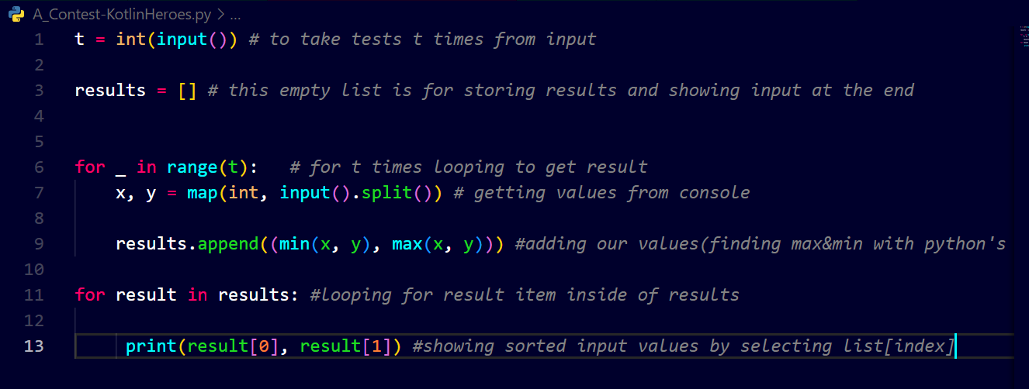
Solution (2)

Slide 7
What you have learned
How to sorting List[] parameters by using two pointers

Slide 8
Questions and Answers

Slide 9
Greetings

